Slide 1
Structuring Start-Ups
October 27, 2022

Slide 2
Overview
Choice of Entity
For Profits
Benefit Corporations/B Corps
Non-Profit Corporations
Founder Arrangements
“Clear” the founders
Splitting the Pie
Founder vesting
Restrictive covenants
Operation of Entity
Employee Equity

Slide 3
Choice of Entity Choices
C Corporation*
S Corporation*
Limited Liability Company*
Sole Proprietorship
Partnership
Limited Partnership
Benefit Corporation* (v. B Corp certification)
Non-Profit Corporations
* Denotes most likely entity choice

Slide 4
Corporate Structure v. LLC Structure
Shareholders
Members
Corporation
Limited Liability Company
Shareholder
Managed by Directors/Officers
Shareholder
Managed by Managers or Members

Slide 5
Choice of Entity
There is no one answer for all companies “It depends…”

Slide 6
Limited Liability – Only Expose the Wager
Form of entity
Importance of formalities-“piercing the corporate veil”
Contractual limitations
Insurance
Hidden liabilities
Unpaid wages and wage taxes
Pass-through entities with no cash to pay tax
Guarantees

Slide 7
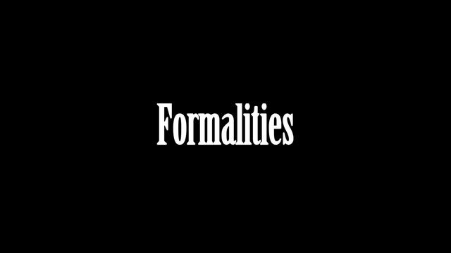
Corporate Formalities
Bank accounts
Signatures
Shareholder/Member and Board Meetings
Corporate Records (including stock)
Filings
State
Tax
Also important for potential investors/purchasers

Slide 8
Tax – Why you should care!
Double Taxation (C Corporation)
Corporate
Individual
Significance
Material cash distributions/dividends
Sale of the Company

Slide 9
Illustration of Double Tax
C Corp
S Corp/LLC
Shareholder
Shareholder/Member
Tax
Tax
Dividend
Dividend/Distribution
Entity
Entity
Tax
No Tax

Slide 10
Example of Double Tax on Sale of Assets
C Corp
S Corp/LLC
Gain $100 $100
Corporate Tax $ 21 $ 0
After-Tax Entity Income $ 79 $100
Individual Tax - capital gain $ 16 $ 20
Individual After-Tax Cash $ 63 $ 80
Assumed Tax Rates
21% corporate
20% capital gain
Point: Single Layer of tax is better – LLC’s, S Corporations

Slide 11
More reasons to care about tax
Section 1202 – Qualified Small Business (benefit for C Corporations)
100% exclusion from capital gains/Potential 50%
5 year minimum holding period
Excluded businesses: professional service businesses; real estate companies; financial services businesses
Maximum: $10 million exclusion per shareholder
Tax-Free Mergers (benefit for corporations)
“Partner” implications (issue for limited liability companies – benefit for corporations)
Self-employment taxes (2.9% of wages)
1099’s and estimated payments
Income on tax returns

Slide 12
S Corporations
Benefits
Simplicity
Pass-through treatment
Down-side
Single class of stock (other than voting)
Limitation on number of shareholders – 100
Only individual and certain non-profit corporation shareholders
Only citizens or residents of the United States may be shareholders

Slide 13
Other Considerations in Deciding Entity
Investor Favorable (C-Corporations)
IPO Favorable (C-Corporations)
Ease of use (e.g., option pools) (corporations)
Relative ease of switching from LLC to C-Corporations

Slide 14
Choice of Entity Considerations
 | C Corporation | Limited Liability Company | S Corporation | Sole Proprietorship/ Partnership
Limited Liability | Yes | Yes | Yes | No
Flexibility in Ownership | Yes | Yes | No | Yes
Taxation  Eliminates Double Taxation/Flow-Through (losses, sale)  Tax-Free mergers on sale  Section 1202 tax favorable treatment | No Yes Yes | Yes No No | Yes Yes No | Yes No No
Flexibility In Structure | Yes | Yes | No | Yes
IPO Favorable | Yes | No | No | No
VC Favorable | Yes | No | No | No
Employer Eligible | Yes | No | Yes | No
Ease of Use | Yes | No | Yes | Yes
Ease of Switching | No | Yes | Yes | Yes

Slide 15
Bottom Line of Entity Choice
No simple answer
“Life-style company” or significant dividends/distributions—consider S Corporation or LLC
Venture-capital oriented
Lean toward a C Corporation
If model is build/sell after 5 years, consider C Corp
Easier to go from LLC to C Corp than reverse

Slide 16
Benefit Corporations and LLCs
For-profit entities that are intended to produce a public benefit(s) and to operate in a responsible and sustainable manner.
Affirmative duties on directors to consider different stakeholders.
39 States (including DE and PA) have adopted legislation authorizing Benefit Corporations/LLC’s and/or other forms of social benefit entities.
May be Taxed as a C Corporation, S Corporation, Partnership, or LLC.
Limited tax benefits in some cities, including Philadelphia

Slide 17
Benefit Corporations and Companies
Advantages
Great Marketing Tool
Strong Commitment to Social Purpose
Legal Protection for Directors
Flexibility for the Board in Case of Sale of the Company
May help with attracting grants or social impact investors
Disadvantages
Traditional Investor Hesitancy / Raising Funds.
Legal Uncertainty/Few Legal Precedents.
Additional Reporting and Disclosure Requirements.
No Tax Incentives (except for small local tax reductions in some cities, including Philadelphia).

Slide 18
B Corp Certification
Not a Legal Entity
Third Party Certification, similar to Fair Trade or LEED certification
Laundry List of Requirements
Purpose
Amendment of Certificate of Incorporation
Annual Reporting Requirements
Other Burdens

Slide 19
B Corp Certification
Advantages
Commitment to Social Purpose
Access to Community of Other B Corps
Marketing Tool for Consumers
Disadvantages
No Tax Incentives
Stringent Requirements
Burdensome Reporting

Slide 20
Nonprofit Corporations
Advantages
Liability protection
Tax-exempt status
Exemption from federal income tax
May be prerequisite for state tax benefits
501(c)(3) status – tax-deductible contributions
Disadvantages
Sharing control and governance
Limitations on distributions
Restrictions associated with tax-exempt status
Public scrutiny

Slide 21
U.S. Tax-Exempt Organizations

Slide 22
501(c)(3) Organizations
Purposes include
Religious
Charitable
Scientific
Testing for public safety
Literary or educational
To foster national/international sports competition
Prevention of cruelty to children, animals
Most favorable status
Exempt from federal income tax
Contributions deductible
Subject to most stringent requirements
Must apply to IRS for tax-exempt status (Form 1023)

Slide 23
501(c)(3) Organizations
Two Types of 501(c)(3) Organizations
Default: Private Foundation
Typically supported by small number of individuals or corporation
Subject to more stringent rules
Typically grant maker; may also be private operating foundation
Public Charities
School, church, hospital
Donative organization
Gross receipts organization
Supporting organization

Slide 24
501(c)(3) Organizations
Organizational and Operational Tests
Purposes limited to exempt purposes
Noncharitable activities may not constitute more than an insubstantial part
No private inurement (distribution of earnings to directors, officers and members)
No political activity
Limited lobbying activity
Dissolution clause → assets devoted to charitable purposes in perpetuity

Slide 25
501(c)(3) Organizations
Prohibition on Private Inurement
No part of net earnings may inure to benefit of insiders
Insiders include founders, directors, officers
Examples
Excessive salaries – Not reasonable & ordinary or necessary
Payment of greater than FMV for property without justification for a premium
Free use of the organization’s property in a manner different from the public
Loans without adequate security or interest

Slide 26
501(c)(3) Organizations
Prohibition on Private Benefit
Private Benefit – Occurs where the organization provides more than an “incidental” benefit to a non-insider
Examples
All examples in inurement slide
Benefit received disproportionately by some
Charitable class too small
Joint ventures with for-profit entities (if not properly structured)

Slide 27
501(c)(3) Organizations
Excess Benefit Transactions – Excise Tax
Transactions between insiders and the organization, where the insider receives funds or property worth more than value of goods/services provided
Includes compensation arrangements
Insider is someone who has substantial influence over affairs of organization (“disqualified person”)
Includes directors, officers, family members, and entities controlled by them
Significant excise taxes
Disqualified person pays 25% of the excess benefit
Board members, if they knowingly participate in the transaction, may pay 10% of the excess benefit

Slide 28
501(c)(3) Organizations
Unrelated Business Income
IRC §512 taxes an exempt organization on its unrelated business income (UBI).
UBI is income from:
A regularly carried on
Trade or business activity
Unrelated to the exempt organization’s charitable purposes
Several exemptions
Penalties
Taxed at standard corporate rates
Revocation of tax-exempt status if substantial

Slide 29
Name of Entity
Check availability
Quick trademark search
Quick “Google” search
Caution: The name of the entity can be changed – don’t overthink it!!!

Slide 30
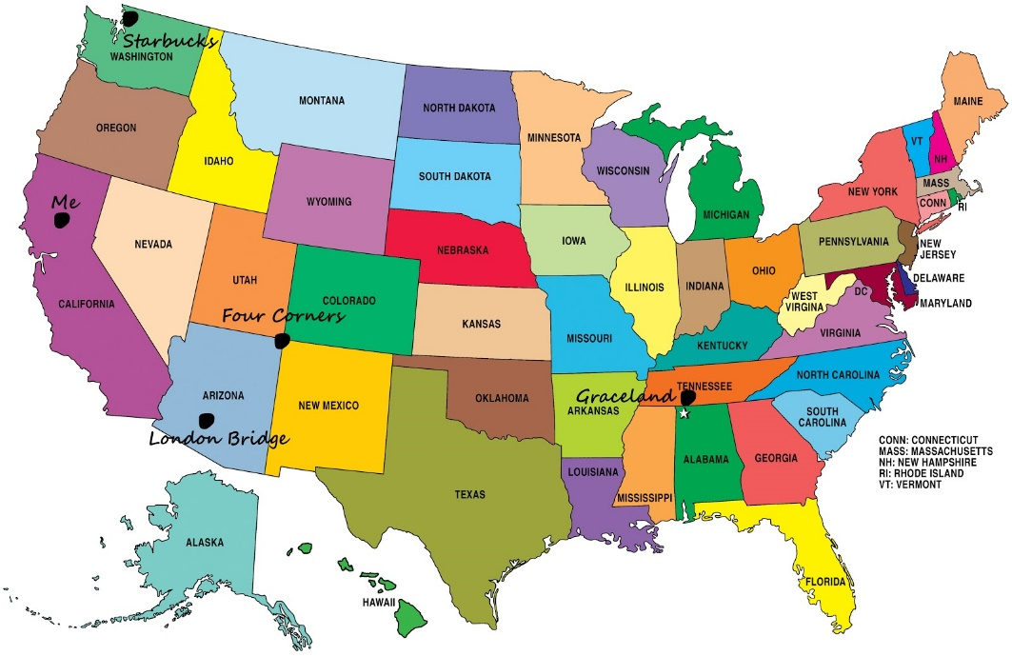
State of Formation
Taxation
Predictability
Cost
Attractive to capital
In general
“Fancy capital structure” or “Venture capital”- Delaware
Otherwise-PA

Slide 31
Founders Roadblocks
Non-competition/non-solicitation
Confidentiality agreements
Fiduciary duties
Intellectual property assignments
Agreements
Policies

Slide 32
Founder Employment/Consulting Arrangements
Role of Founder going forward
Compensation
Intellectual Property Assignments—critical
Restrictive Covenants
Confidentiality – no limitation
Non-compete
Non-solicit (employees and customers)
Term and geographic limitations
Severance

Slide 33
Founder Equity Arrangements—Splitting the Pie
Lessons Learned
Keep in mind the inevitable dilution
Keep it simple (i.e., Avoid fancy formulas)
Err on the side of incenting those who are providing value going forward
Even splits are not usually the right answer
Beware of the dreaded “50/50”
Shot-gun
Third party director
Arbitration

Slide 34
Use Demmler’s Founders’ Pie Calculator
Evaluate related contributions
Weight
Consider relative contributions (current and anticipated)
Idea
Business Plan
Domain Expertise
Commitment and Risk
Responsibilities

Slide 35
Demmler Founder Pie Chart – Example
Inventor – leader in domain
“Business guy” – business and industry knowledge
Technology – Inventor’s right-hand man
Research team member – no future

Slide 36
Demmler Founder Pie Chart (Example)
Founder 1
Founder 2
Founder 3
Founder 4
Weight
Inventor
Business Guy
Technologist
Researcher
Idea | 7 | 10 | 3 | 3 | 0
Business Plan | 2 | 3 | 8 | 1 | 0
Domain Expertise | 5 | 6 | 4 | 6 | 4
Commitment & Risk | 7 | 0 | 7 | 0 | 0
Responsibilities Going Forward | 6 | 0 | 6 | 0 | 0

Slide 37
Demmler Founder Pie Chart (Example)
Founder 1
Founder 2
Founder 3
Founder 4
Inventor
Business Guy
Technologist
Researcher
Idea | 70 | 21 | 21 | 0
Business Plan | 6 | 16 | 2 | 0
Domain Expertise | 30 | 20 | 30 | 20
Commitment & Risk | 0 | 49 | 0 | 0
Responsibilities | 0 | 36 | 0 | 0
Total Points | 106 | 142 | 53 | 20 | 321
% of Total | 33.0% | 44.2% | 16.5% | 6.2% | 100.0%

Slide 38
Founder Equity Arrangements
Vesting Arrangements
Amount of vested stock
Length of time of vesting
Buy-back arrangements
Effect of termination and/or sale of company
Consider impact of Seed/Venture Financing

Slide 39
Operational Considerations
Decision-Making/Management
Directors/Managers
Right to appoint
Officers
Majority v. super-majority decision-making
Board
Member/Shareholder
Restrictions on Transfer
Absolute prohibition or Company consent
Rights of first refusal

Slide 40
Employment/Consulting Arrangements – Similar to Founders
Term/severance
“At-will”
Intellectual Property Assignments—critical
Restrictive Covenants
Confidentiality – no limitation
Non-compete [Difficult to enforce with consultants]
Non-solicit (employees and customers)
Term and geographic limitations

Slide 41
Employee Equity
Types of Equity
Restricted equity (corporations; LLC’s)
Options
Qualified Options (corporations only)
Non-Qualified Options (corporations; LLC’s)
Profits Interests (LLC’s)
Phantom Equity (corporations; LLC’s)

Slide 42
Other Terms
Vesting
Time-Based
Performance-Based
Repurchase Right
Vested
Non-vested

Slide 43
Amount of Employee Equity
Amount necessary to attract and retain talent
A huge option pool may work against you
Don’t go too low in the employment pool

