Slide 1
Start Smart Law: Building and Leveraging Your Professional Team Kit Needham Assistant Dean for Entrepreneurship Initiatives Director, Project Olympus

Slide 2
Start with Your Lawyer

Slide 3
What to Look For
Type
Domain Experience
Price
Affinity/Chemistry
Belief in Your Idea

Slide 4
TYPE
HBR: Top 10 Legal Mistakes Made by Entrepreneurs
#8 – Hiring a lawyer not experienced in dealing with entrepreneurs and venture capitalists.
Ask: “How many start-ups have you worked with? Can I talk to them?” “What other types of lawyers will I need?”
Notes:
Just like doctors, lawyers specialize in certain types of law. You want a lawyer that specializes in startups

Slide 5
Start-Up Experience Startup lawyers know how to do this. Litigation attorneys, family lawyers, etc. probably won’t.
Example 1 Example 2
$250,000 $250,000
Priced Round Conv. Debt
Founder 41% 46%
Employees 7% 8%
F&F 12% 6%
Series A 40% 40%
Total 100% 100%
Notes:
Litigation attorneys, contracts, IP lawyers etc.may not know how to do this. You need experience

Slide 6
Domain Experience
Software?
Medical Devices?
Manufacturing?
Target Market/Customers?
Federal Government?
Ask: “Have you worked with other startups like mine?”
Notes:
Lawyers develop expertise and contacts in the domains they specialize in. Example: medical devices – probably familiar with the FDA, different classes of devices, etc.

Slide 7
Price
Hourly Rates vs Flat Fees for a bundle of services
Deferred payment
Rates/options for services such as copies
Ask:
“What type of legal expenses can I expect?”
“Do you offer packages?”
“Will you consider deferring charges?”

Slide 8
Affinity/Chemistry
Are you comfortable asking questions?
Do you communicate well?
Do you ‘get’ each other?
Are your questions being answered?
Ask: “How do you feel about working with students?”

Slide 9
Belief in Your idea
Do they display interest and enthusiasm?
Did they do any research before meeting you? (if you briefed them on your idea)
Do they buy into your vision – believe in what your company is all about?
Ask: “What do you think of the potential for my idea/business? Any initial thoughts?”
Notes:
It is not essential that they fully believe in your idea but having a lawyer who sees the potential is a more positive relationship.

Slide 10
Other Questions*
What percentage of your practice over the last few years has been startups?
How many startups began with you and remain with you after having revenues of or having raised more than $1M?
How many investment deals have you brokered recently?
What was the smallest investment? The largest?
Do you charge for attending board meetings?
What clients can I talk to about your representation?
*From “Startup Briefs” by Babs Carryer
Notes:
It is not essential that they fully believe in your idea but having a lawyer who sees the potential is a more positive relationship.

Slide 11
TIPS – Managing the Relationship
Read and understand Letter of Engagement – it’s your job
Negotiate – okay to discuss changes to the Agreement
Ask if you can talk to one or two clients who are similar to you

Slide 12
Tips – Managing Costs
Decide whether you want to pre-approve payment for copies, telephone calls…
Ask that projects and budgets be defined before work begins
Magic Write-In: “Until notified by client, all billing costs for work to be completed must be discussed in detail and agreed upon in writing by both parties and pre-approved before work begins.”

Slide 13
TIPS – Being a Good Client
Don’t defer payments too long.
Consider paying a minimum retainer.
Read and understand the documents
Pay your bills on time.
Do some research on your own by Attending Start Smarts or using other Olympus/IPI Resources

Slide 14
Firing a Lawyer
Stops being accessible OR responsive.
Overcomplicates contracts and negotiations
Sloppiness, errors – can happen over time.
Frequently last minute
Charges exceed quoted amount or show up unexpectedly

Slide 15
Advisors, Boards and Service Providers

Slide 16
The role of Directors and Advisors are different
Directors support your obligation towards proper corporate governance.
Advisors provide support without any fiduciary responsibilities or liabilities

Slide 17
What is an advisor/advisory board?
An individual or group of individuals
who help management move their business forward.

Slide 18
Why do I need an advisor?
Functional support
Emotional support
Access to financial investors
Access to customers

Slide 19
Why do advisors do it?
Goodness of their heart – they believe in you
Stay involved in the field or a business at your stage
Cash money and/or equity
Create a job for themselves

Slide 20
Advisors/Mentors vs Advisory Team
Advisors/Mentors/Coaches
Volunteers who give you advice on an as-needed basis
No fiduciary responsibility
Diverse background – legal, PR, domain, financial
Not paid – think of them as mentors/coaches/experts
Advisory Team
Volunteers who give advice on a regular basis
Can give investors confidence
May get equity but generally under 1% and vests over time
No fiduciary responsibility

Slide 21
Keeping Advisors Informed and Engaged
One-on-one meetings (time-consuming but best for sensitive or complicated issues)
Periodic Advisory Team meetings
Requires more organization
Helps to avoid ‘mentor whiplash’
Email Updates
Every two-four weeks
Include other founders and employees
3-4 bullet points
Can include an ”ask”
”Managing” your advisors

Slide 22
What is a Board of Directors?
A fiduciary obligation required by your Articles of Incorporation.
Explicitly represent the interests of your shareholders.
Have a real exposure to corporate liability.

Slide 23
Why do you need a Board?
Legal requirement for Incorporation.
Adult supervision – keep you out of the weeds as you make key decisions.
Fundraising and Business Development support.

Slide 24
Why do folks join your Board?
Contractual right to a Board seat
You as the entrepreneur
A financial investor
Independent
Provides key access to interesting opportunity
Mission orientation
Get cash money and/or equity

Slide 25
Board of Directors
Boards
Fiduciary responsibility (e.g. legal)
Obligated to do what is best for the company and shareholders
Tip: Keep it small
Board responsibilities
Hire and fire the CEO
Approve strategic direction
Assess benefits and risks of the company’s activities
Help with raising funds
Help find customers

Slide 26
Service providers
Accountants, attorneys, bankers etc. are NOT employees
Generally should not be board members
Attorneys formally incorporate the company
Also provide boiler-plate docs, patent/IP work
Remember: they work for the company, not you
You will eventually need a personal attorney
Payroll is almost always outsourced

Slide 27
Appendix

Slide 28
Top 10 Legal Mistakes Made by Entrepreneurs HBR: March 3, 2003
Waiting to consider international IP protection.
Disclosing inventions without a nondisclosure agreement, or before the patent application is filed.
Starting a business while employed by a potential competitor, or hiring employees without first checking their agreements with the current employer and their knowledge of trade secrets.
Promising more in the business plan that can be delivered and failing to comply with state and federal securities laws.
1. Thinking any legal problems can be solved later.
Notes:
1. Some have had really happy experiences, some have had bad first experiences, all are in a happy place right now.
1. Panelists’ choice whether they wish to name the lawyer or not.

Slide 29
Top 10 Legal Mistakes Made by Entrepreneurs HBR: March 3, 2003
10. Failing to incorporate early enough.
9. Issuing founder shares without vesting.
Hiring a lawyer not experienced in dealing with entrepreneurs and venture capitalists.
Failing to make timely Section 83 (b) election.
Negotiating venture capital financing based solely on the valuation.
Notes:
1. Some have had really happy experiences, some have had bad first experiences, all are in a happy place right now.
1. Panelists’ choice whether they wish to name the lawyer or not.

Slide 30
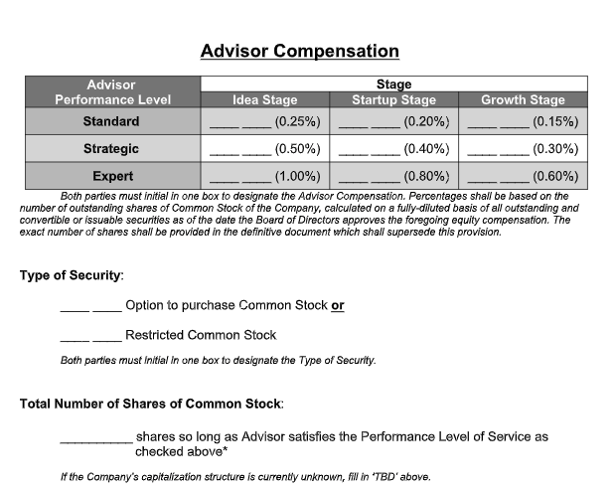
From the Founders Institute

Slide 31
Kit Needham kit@cmu.edu
cmu.edu/olympus

